Slide 1
Alphabet Soup Analysis
Module 21 Challenge
Rae Ann Gregg
3.11.24

Slide 2
Alphabet Soup Overview
The purpose of this project is to create a tool for Alphabet Soup to help select applicants for funding with the best chance of success in their ventures.
The provided dataset was used to create a binary classifier using a machine learning program to predict whether applicants will be successful if funded by Alphabet Soup.
The provided dataset included more than 34,000 organizations that have received funding from Alphabet Soup over the years.
The following information was provided in the dataset for use in the program to predict probability of success with at least 75% accuracy:
EIN and NAME—Applicants
APPLICATION_TYPE—Alphabet Soup application type
AFFILIATION—Affiliated sector of industry such as Independent or Company Sponsored
CLASSIFICATION—Government organization classification
USE_CASE—Use case for funding such as Product Development, Preservation, Healthcare, etc.
ORGANIZATION—Organization type such as Association, Co-operative or Trust
STATUS—Active status
INCOME_AMT—Income classification
SPECIAL_CONSIDERATIONS—Special considerations for application
ASK_AMT—Funding amount requested
IS_SUCCESSFUL—Was the money used effectively

Slide 3
Alphabet Soup Analysis Results
Data Preprocessing
The focus of this model is to predict the probability of success for an applicant if they receive funding.
The IS_SUCCESSFUL data was the target variable used for the model.
The other columns were used as feature variables for the model except the EIN column. I originally also removed the NAME column as suggested in the instructions. However, the accuracy increased when I included the NAME column and binned the NAME data.
The EIN column was removed since it was only introducing noise into the model and was not needed to predict the probability of success for funding.
I used binning/bucketing with the APPLICATION_TYPE, CLASSIFICATION, and NAME columns to combine the rare occurrence categories to optimize the model.
The categorical data was converted into numeric data using get_dummies.
The data was split 80/20 into training and testing data and scaled for a more balanced distribution.

Slide 4
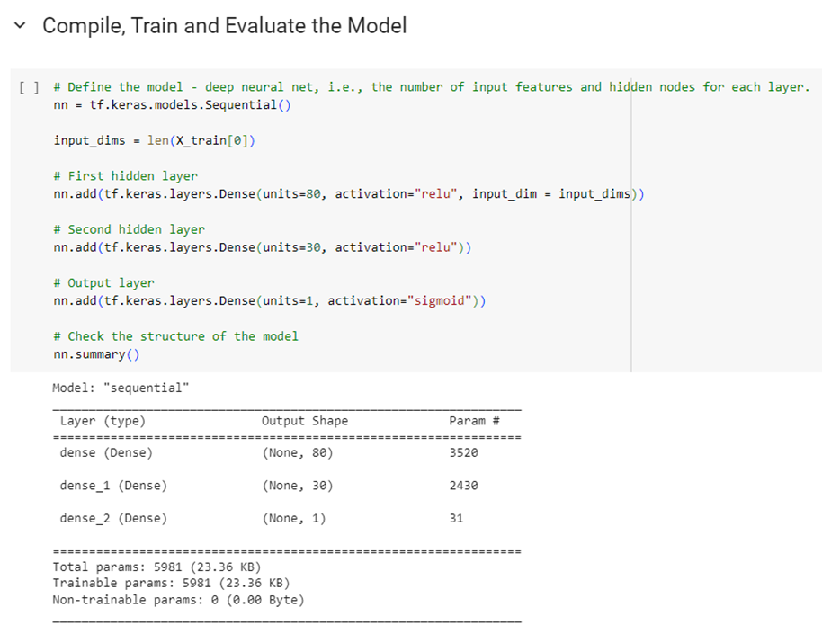
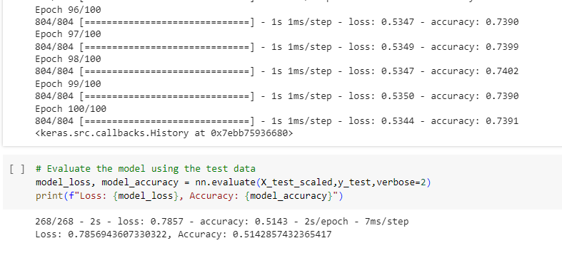
Alphabet Soup Analysis Results
Compiling, Training, and Evaluating the Model
I did 5 optimizations to get to the target of over 75% accuracy
Original Mode
Dropped EIN and Name Columns
1st layer – 80 neurons with ReLU activation
2nd layer – 30 neurons with ReLU activation
Output layer – 1 neuron with Sigmoid activation
100 epochs
51.43% Accuracy

Slide 5
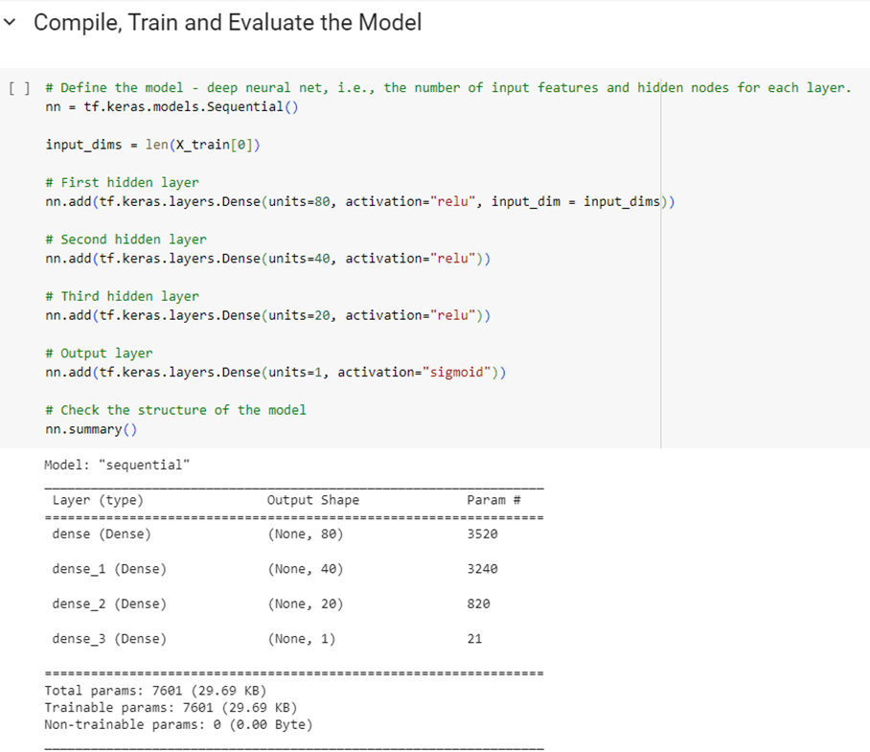
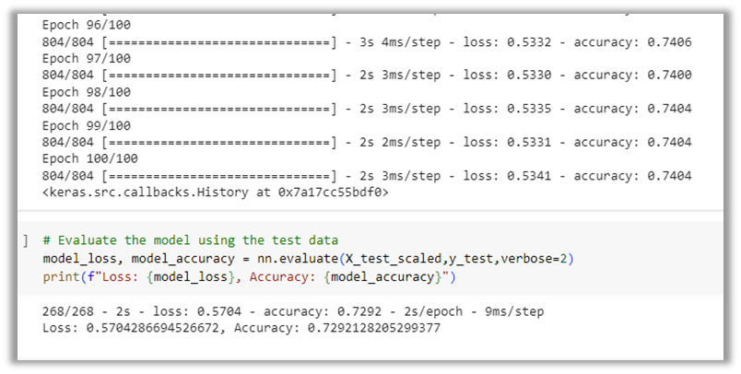
Alphabet Soup Analysis Results
Compiling, Training, and Evaluating the Model
I did 5 optimizations to get to the target of over 75% accuracy
Optimization 1 – added a hidden layer and increased the nodes
Dropped EIN and Name Columns
1st layer – 80 neurons with ReLU activation
2nd layer – 40 neurons with ReLU activation
3rd layer – 20 neurons with ReLU activation
Output layer – 1 neuron with Sigmoid activation
100 epochs
72.92% Accuracy – increased by over 20%

Slide 6
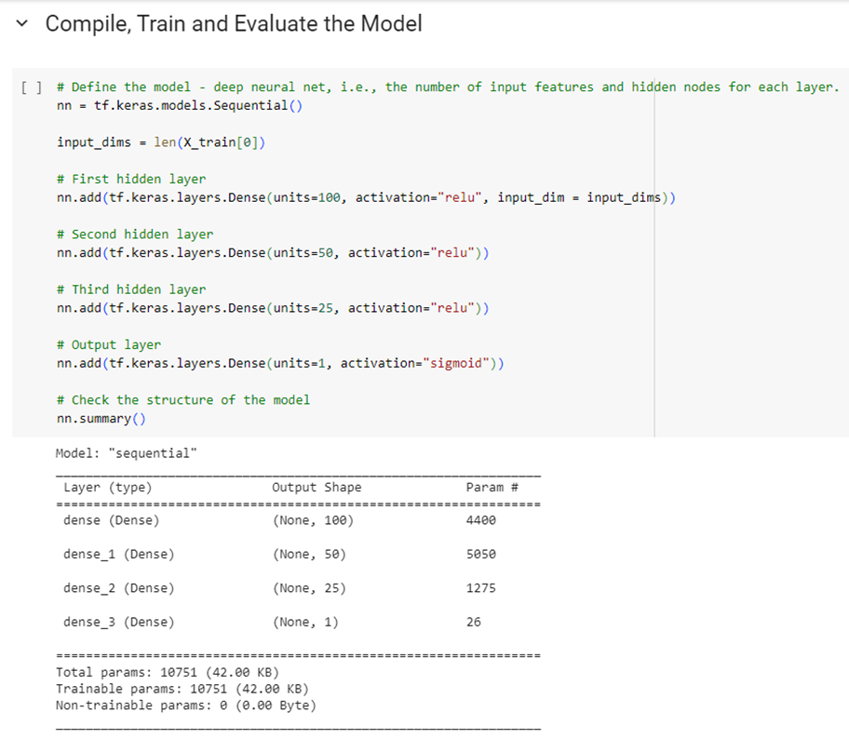
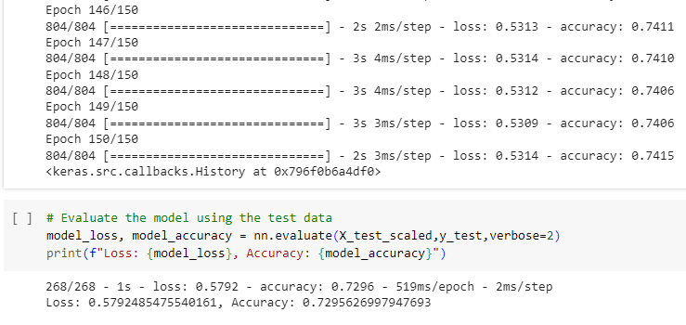
Alphabet Soup Analysis Results
Compiling, Training, and Evaluating the Model
I did 5 optimizations to get to the target of over 75% accuracy
Optimization 2 – increased the nodes and the epochs
Dropped EIN and Name Columns
1st layer – 100 neurons with ReLU activation
2nd layer – 50 neurons with ReLU activation
3rd layer – 25 neurons with ReLU activation
Output layer – 1 neuron with Sigmoid activation
150 epochs
72.96% Accuracy – slightly more accurate

Slide 7
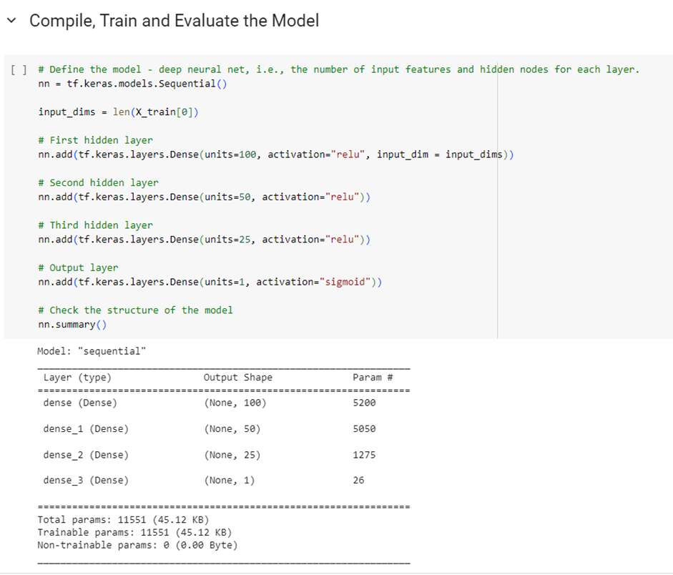
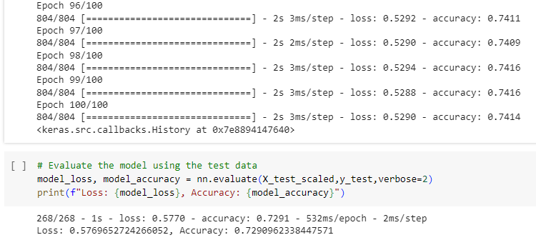
Alphabet Soup Analysis Results
Compiling, Training, and Evaluating the Model
I did 5 optimizations to get to the target of over 75% accuracy
Optimization 3 – adjusted to fewer bins and reduced the epochs back to 100
Dropped EIN and Name Columns
Changed app count cut off from 500 to 50
Changed class count cut off from 1000 to 100
1st layer – 100 neurons with ReLU activation
2nd layer – 50 neurons with ReLU activation
3rd layer – 25 neurons with ReLU activation
Output layer – 1 neuron with Sigmoid activation
100 epochs
72.91% Accuracy - slightly less than Optimization 2

Slide 8
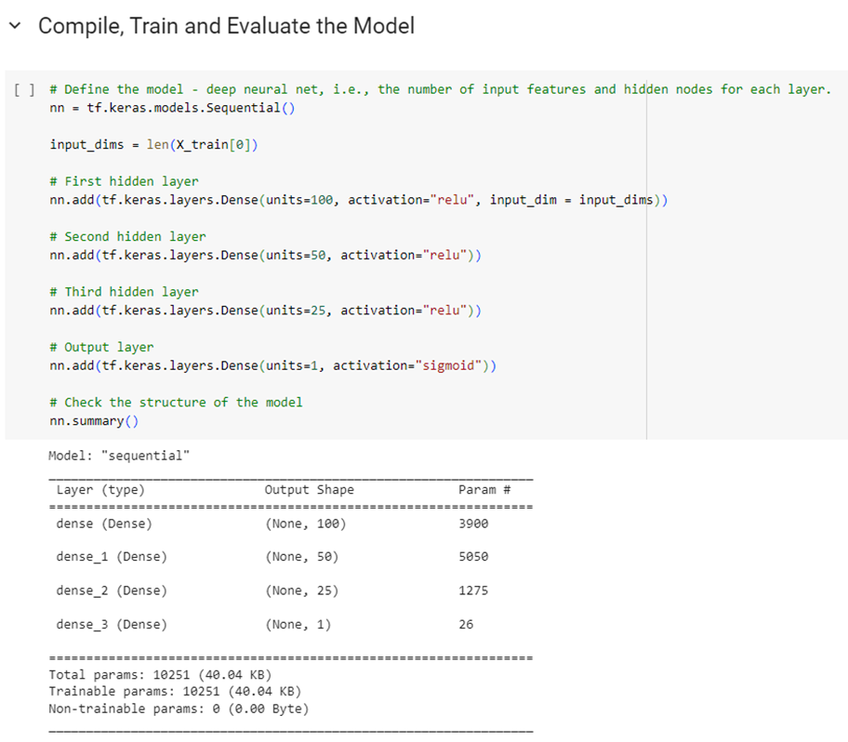
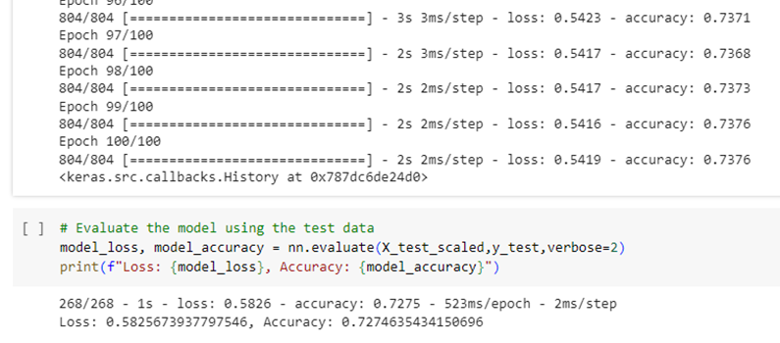
Alphabet Soup Analysis Results
Compiling, Training, and Evaluating the Model
I did 5 optimizations to get to the target of over 75% accuracy
Optimization 4 – created more bins
Dropped EIN and Name Columns
Changed app count cut-off from 500 to 1000
Changed class count cut-off from 1000 to 2000
1st layer – 100 neurons with ReLU activation
2nd layer – 50 neurons with ReLU activation
3rd layer – 25 neurons with ReLU activation
Output layer – 1 neuron with Sigmoid activation
100 epochs
72.75% Accuracy – slightly less accuracy

Slide 9
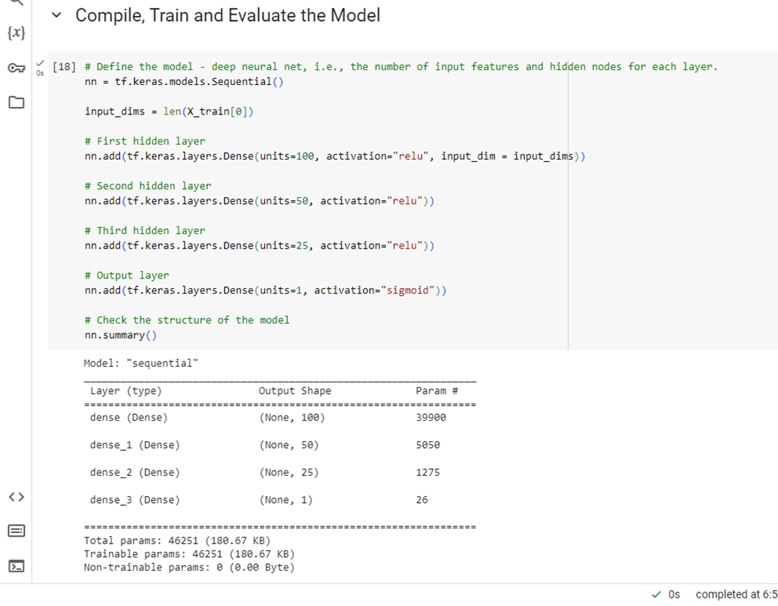
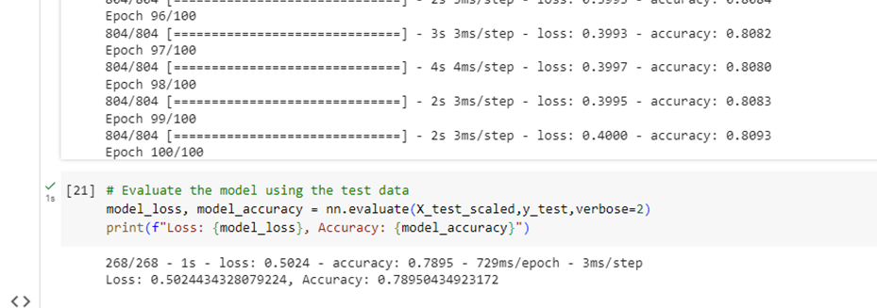
Alphabet Soup Analysis Results
Compiling, Training, and Evaluating the Model
The 5th Optimization was successful with almost 79% accuracy
Adding an additional layer and increasing the neurons improved the accuracy over 20% from 51% to almost 73%.
Including the NAME data and binning this data improved the accuracy from almost 73% to almost 79% to reach the target of over 75% accuracy.
Optimization 5 – Did not drop the NAME column and binned the NAME data
Dropped EIN Column
Changed app count cut-off back to 500
Changed class count cut-off back to 1000
1st layer – 100 neurons with ReLU activation
2nd layer – 50 neurons with ReLU activation
3rd layer – 25 neurons with ReLU activation
Output layer – 1 neuron with Sigmoid activation
100 epochs
78.95% Accuracy achieved to reach the target accuracy

Slide 10
Alphabet Soup Analysis Results Summary
Overall, by using machine learning, we can predict with almost 79% accuracy which campaigns will be successful. This will help us fund campaigns more efficiently.
We could continue to try other models to improve the accuracy even more.
The greatest gains in accuracy were gained from adding layers and neurons and including the NAME data.
Continuing to adjust the layers, neurons, and binning could further increase the prediction accuracy.
The Tanh model could also be used to try to increase the accuracy since it will normalize the data.
The Random Forest Model can also be used to create a decision tree to find the predictive variables. The Random Forest Model will build multiple trees. Each tree will be trained independently which helps to reduce overfitting. This could also increase the accuracy of predicting successful campaigns.

